Slide 1
Environmentally Responsible Consumption

Slide 2
Defining Consumption
The selection, adoption, use, disposal and recycling of goods and services, as opposed to their design, production and marketing. (Wikipedia)
Purchase of goods or services for any purpose. www.turnerlearning.com/efts/bball/econglos.htm

Slide 3
Defining environmetally responsible consumption
Little or no impact on the native ecosystem or environment.
When we choose something because it is environmentally friendly or socially just, we make it easier for more such products and services to be developed in the future.
To be a responsible consumer is to realize that we have the power to help change the world through the choices that we make everyday.

Slide 4
Conti…
Responsible consumption is a democratic citizens' movement. It influences the behavior of manufacturers, distributors and retailers, and encourages decision makers to adopt policies that protect the environment and the rights of citizens.

Slide 5
The problem
Nearly every purchase an individual or organization makes has hidden costs for the environment and for the world’s people
Many products
require huge inputs of wood, energy, metals, and other resources that are not always renewable
contain toxic chemicals that endanger our health

Slide 6
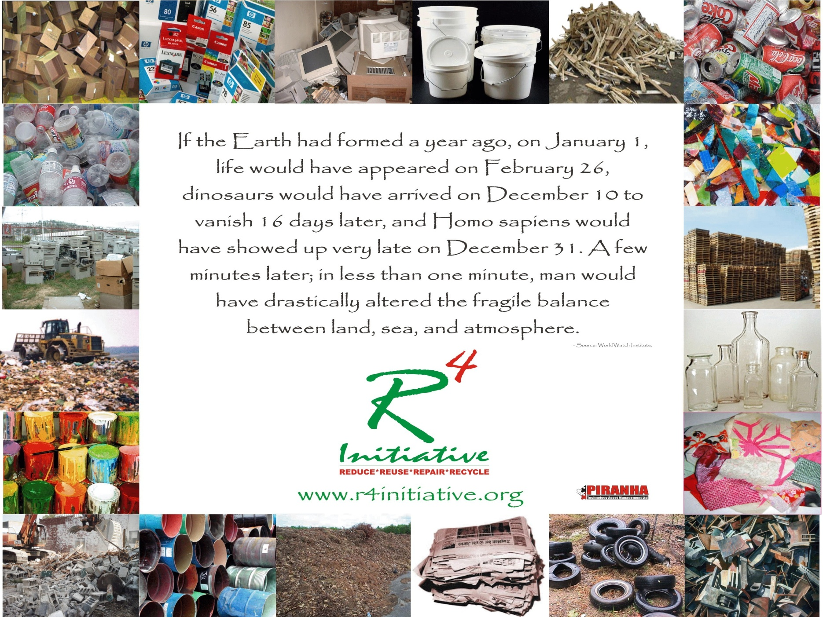

Slide 7
Current practice
Purchasing policies
Materialism & consumerism
Green as a brand instead of purpose
Zero regulatory requirements
No manufacturer responsibility

Slide 8
The challenges
Availability of alternatives
Cost
Overcoming culture & mindsets – we can’t buy less
Changing what and how we buy
Education
In the big picture, consumption continues but the patterns of consumption and the relationship of consumption to the earth in terms of non-toxicity, recyclability, fair trade etc. can and must improve.
Institutions will also need to find ways to meet their needs without buying new products, such as
- eliminating unnecessary purchases
- extending the lives of existing products
- diverting used goods from being sent to landfills

Slide 9
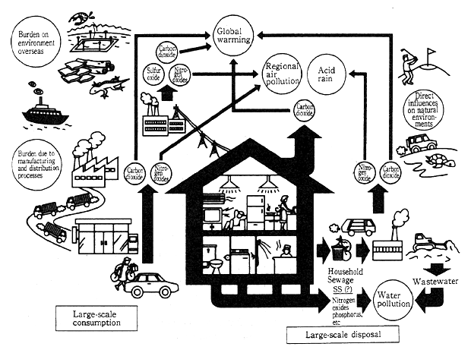

Slide 10
Solutions
Objectives for eco-friendly products:
Products that promote resource conservation and recycling – reduce weight and number of parts; use recycled materials; reduce waste generation etc.
Products that save energy – reduce fuel and power consumption; use energy etc. effectively
Products that use less chemicals – reduce the use of chemical substances; shift from chemical substances to alternative materials etc.
Products that reduce the environmental burden – reduce exhaust gas; reduce noise; reduce construction waste soil; prevent water pollution; implement landscaping and greening etc.
Products that conserve and restore the environment – reduce waste and recycle etc.; purify water

Slide 11
Solutions – Kicking the habit
Education
Legislation
Availability
Creativity
Buy less, give more

Slide 12
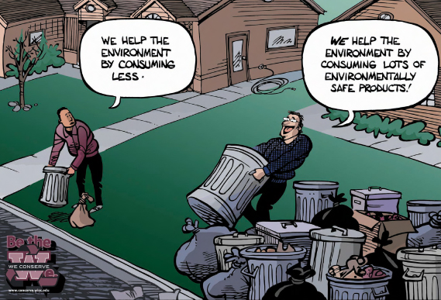

Slide 13
Hierarchy of Change
Individuals – make demands, boycott, start at home
Institutions – build environmental factors into the business model (demonstrated financial advantages)
recycled content
energy efficiency
less packaging
use of sustainably managed resources,
Governments – create and rigorously enforce legislation, provide tax breaks, in-house purchasing policies
Collectively – greater demand will also mean larger markets for green products and more affordable purchases, spread the word and generate interest

Slide 14
How to implement?
Principle of consumerism – Reduction in Packaging/Plastic Bags
Choose products with bulk/economic pack
Choose products with minimal packaging
Bring Your Own Bag (BYOB) or reuse plastic bags

Slide 15
How to implement?
Common“environmentally-friendly”wordings:
Recycled
Ozone Friendly
Environmentally-Friendly
Biodegradable
No Animal Test

Slide 16
Implementation at home
Choose products with higher energy efficiency :
Refer to the energy efficiency label for appliances such as refrigerators and air conditioners
Choose washing machines and dryers that require less electricity and water.
Select alternating current over direct current
Choose detergents that do not contain toxic chemicals
Reduce the use of chemical pesticides, turn to use natural pesticides
Reduce the use of disposable articles
Choose Unbleached/White Toilet Paper

Slide 17
Green consumerism in office
Choose of energy-efficient appliances:
Computer with energy-saving mode and automatic shutdown functions
Printers and photocopies that handle double-side printing, with various modes that adjust levels in ink use
Air conditioning systems that consumes less energy, or systems with automatic adjustment features
Use fluorescent lighting, energy-saving light bulbs
Reduce the use of paper:
Select paper of lighter weight for editing and printing documents
Use recycled papers
Documents should be kept electronically to reduce the use of paper.
Using solar-powered calculator and refillable stationery
Avoid using disposable plastic or paper utensils
Switch to electronic media such as electronic mails (emails), electronic greeting cards, etc

Slide 18
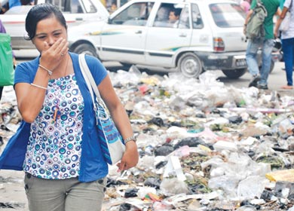
If we are responsible we don’t need to face it.

Slide 19
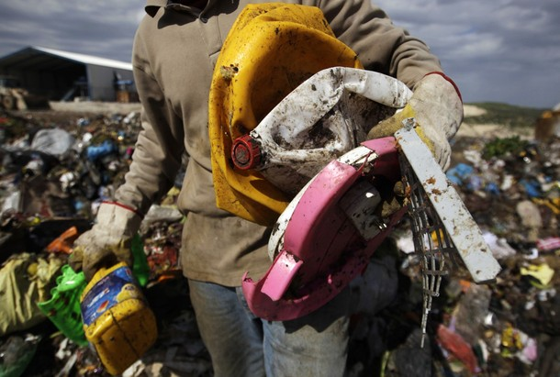
Real Environmentallist

Slide 20
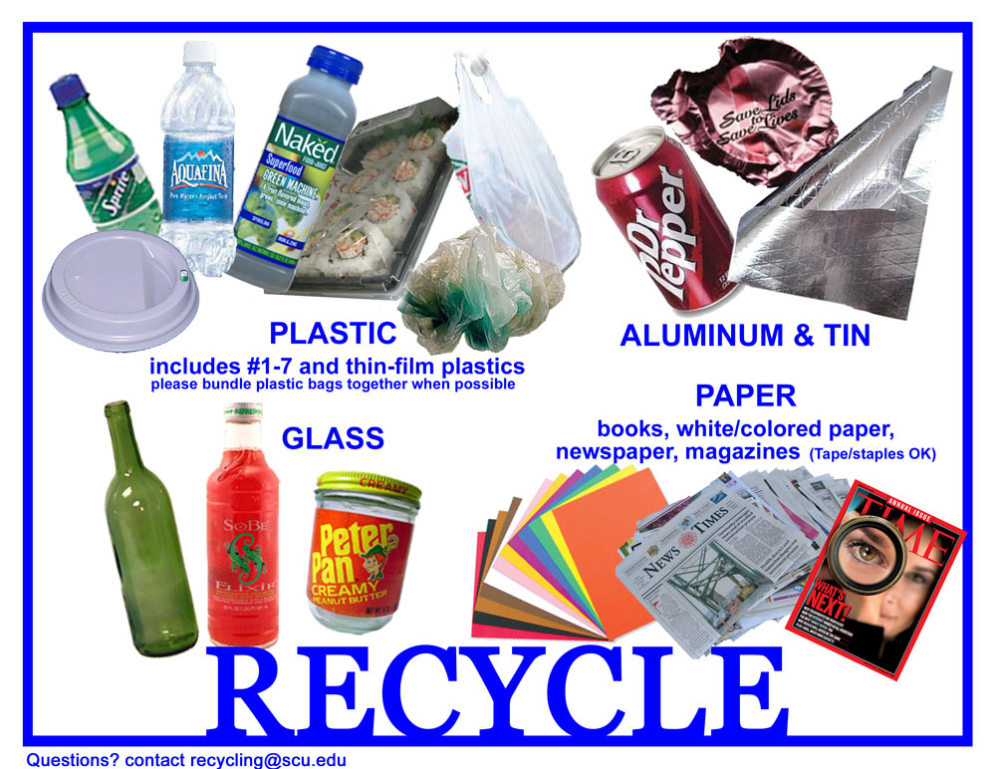
Atleast we can do this much

Slide 21


Slide 22
Thank you

